Slide 1
„Emission & Regeneration“ Unified Field Theory Osvaldo Domann
Methodology
Main characteristics of Fundamental Particles (FPs)
Unified field for all forces
Coulomb law
Ampere law
Induction law
Time quantification
Gravitation laws
Momentum and force Quantification

Slide 2
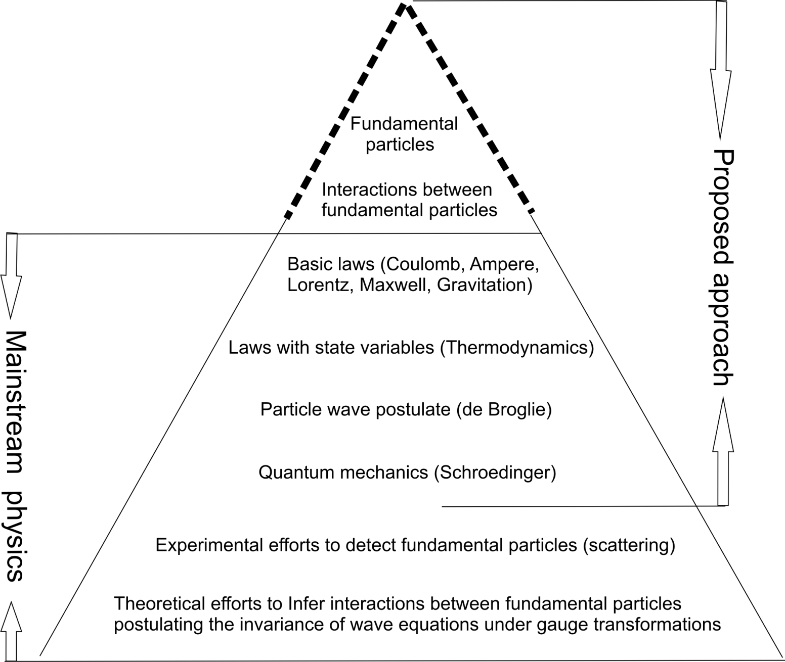
Methodology
Postulated

Slide 3
Particle representation

Slide 4
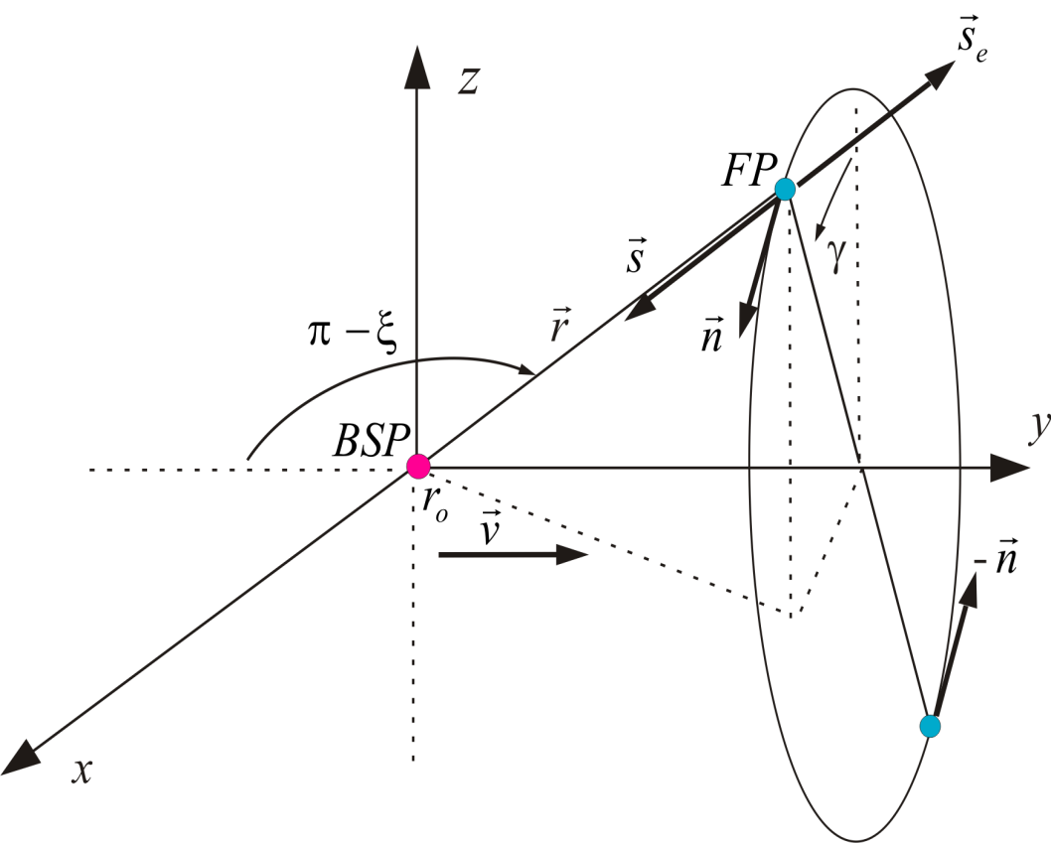
Introduction
Distribution in space of the relativistic energy of a BSP with v c

Slide 5
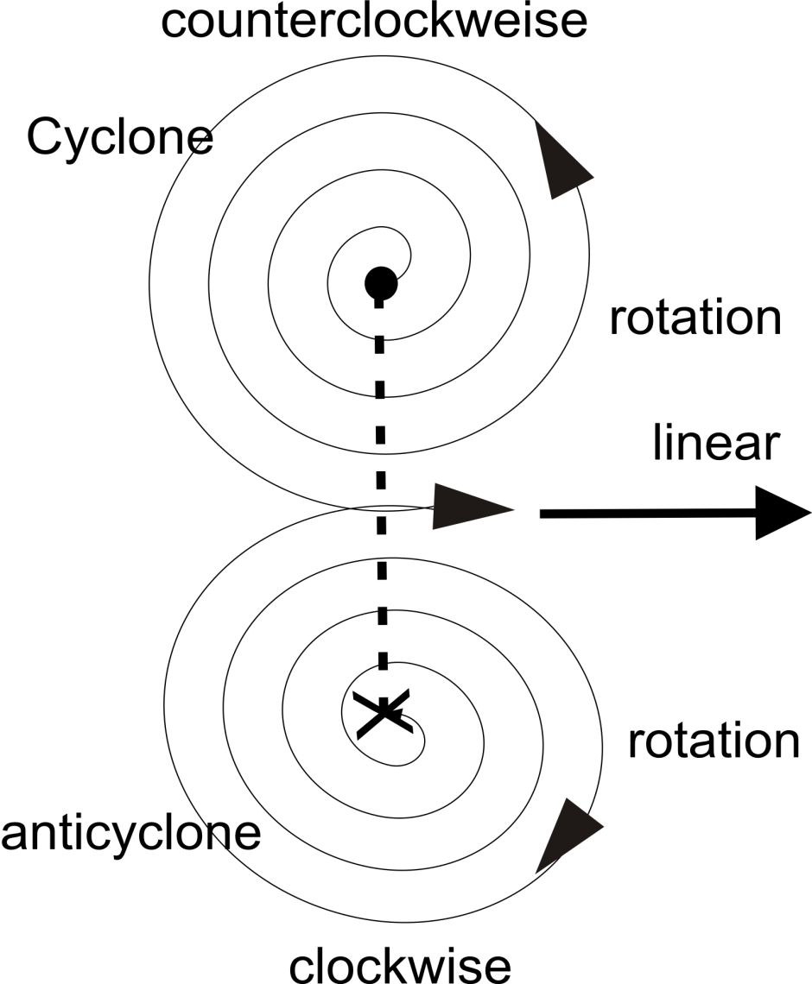
Introduction
Linear momentum out of opposed angular momentum

Slide 6
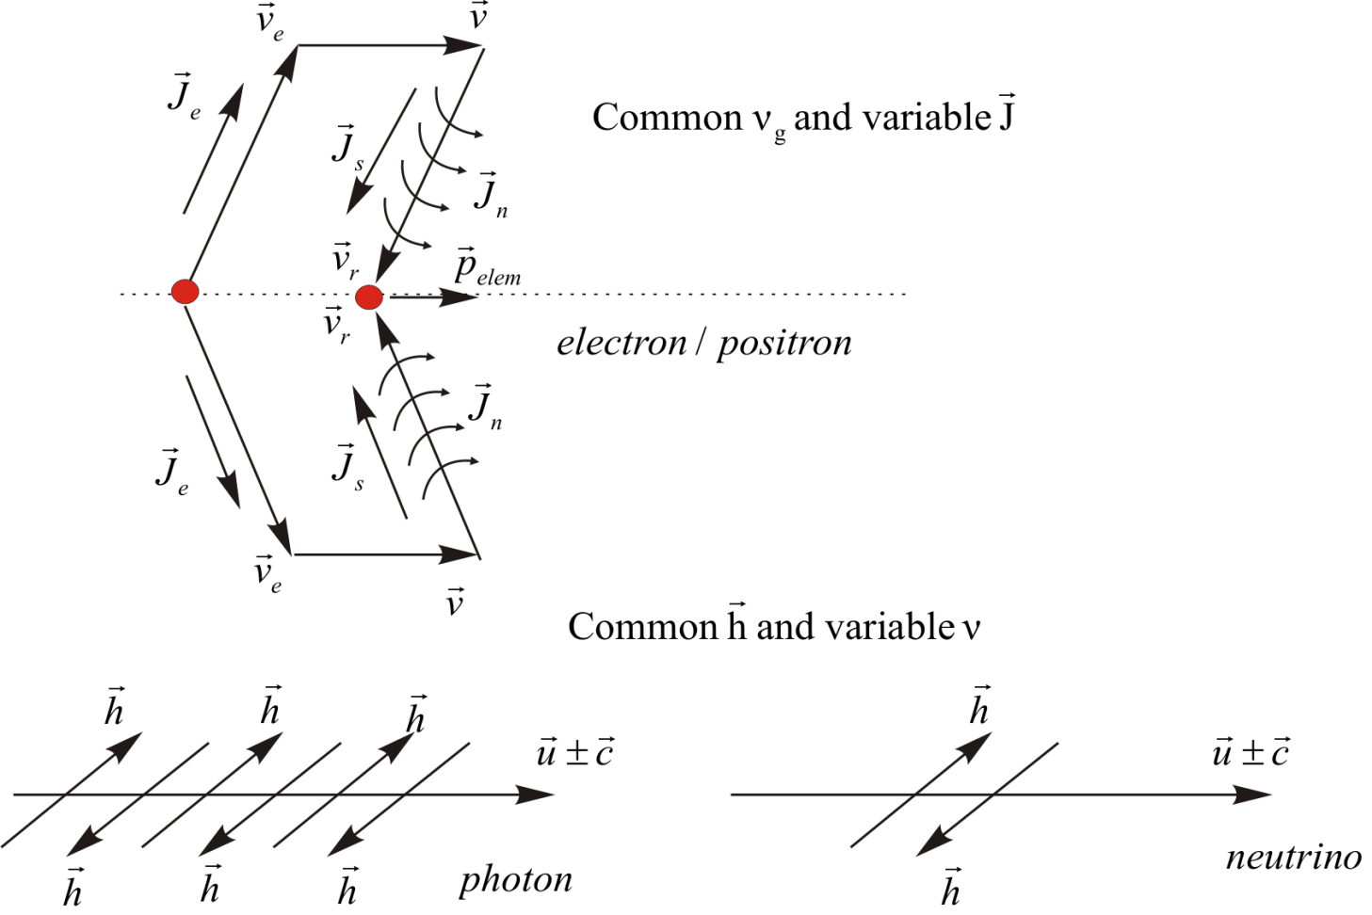
Introduction
Moving particles with their angular momenta

Slide 7
Introduction
Definition of field magnitudes dH
Longitudinal emitted field
Longitudinal regenerating field
Transversal regenerating field
Relation between the angular momentum J and the dH Field

Slide 8
Characteristics of the introduced fundamental particles (FPs)
Fundamental Particles are postulated.
FPs move with light speed relative to the focal point.
FPs store energy as rotations in moving and transversal directions
FPs interact through their angular momenta or dH fields.
Pairs of FPs with opposed transversal angular momenta generate
linear momenta on subatomic particles.
Classification of Subatomic Particles
Basic Subatomic Particles (BSPs) are the positrons, the electrons
and the neutrinos
Complex Subatomic Particles (CSPs) are composed of BSPs and are
the proton, the neutron, nuclei of atoms and the photons.

Slide 9
Index
Interaction laws between two BSPs (electrons and positrons)
1) Interaction between two static BSPs (Coulomb)
2) Interaction between two moving BSPs (Ampere, Lorentz, Bragg)
3) Interaction between a moving and a static BSP ( Maxwell, Gravitation)
These three interactions between BSPs correspond to the three following interactions between the longitudinal and transversal dH fields of the
Interacting BSPs.
1)
Longitudinal X longitudinal (Coulomb)
2)
Transversal X transversal (Ampere)
3)
Transversal X longitudinal (Induction)
The three following slides show each interaction in detail.

Slide 10
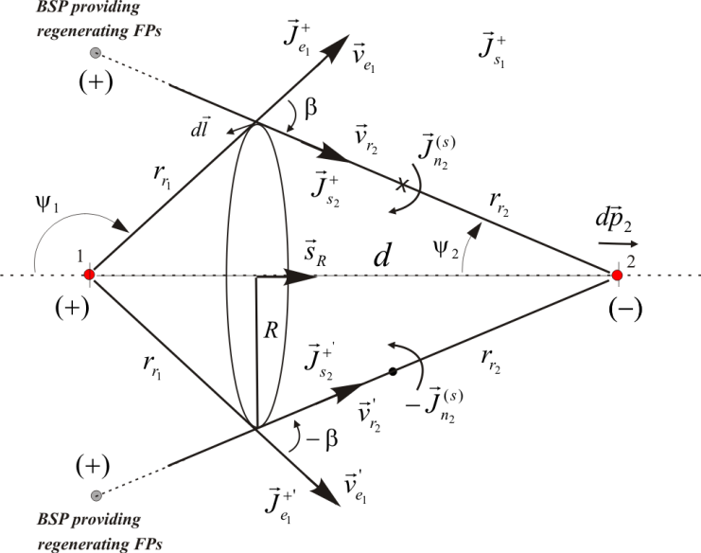
Coulomb law
1) Interaction law between two static BSPs (Coulomb)

Slide 11
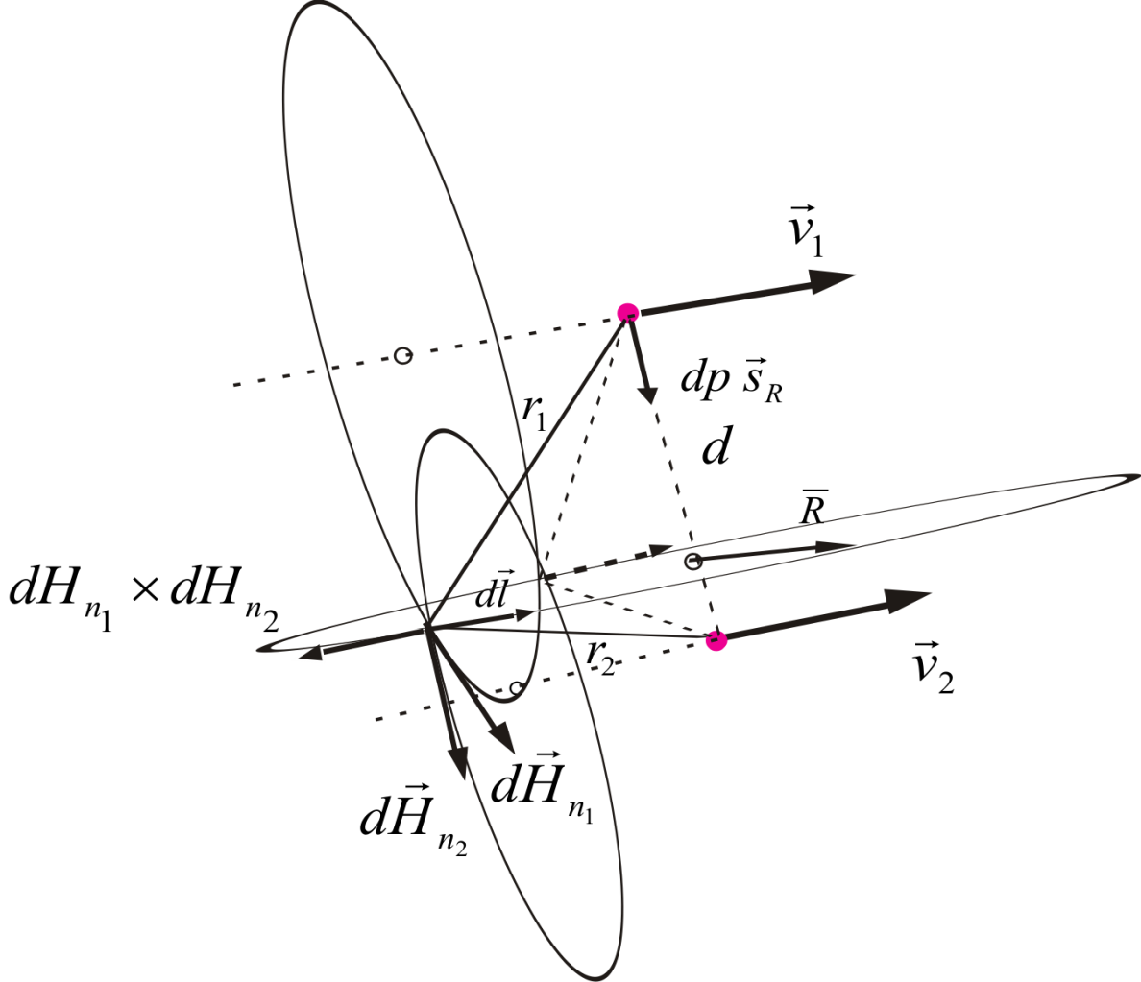
Ampere law
2) Interaction law between two moving BSPs (Ampere, Lorentz and Bragg)

Slide 12
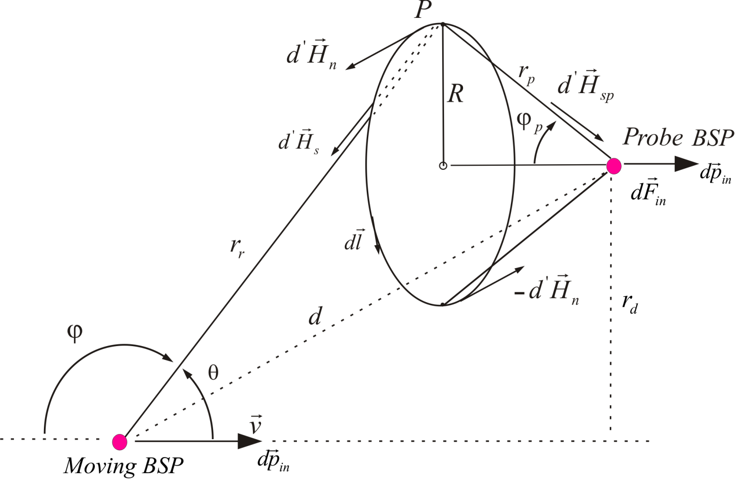
Induction law
3) Interaction law between a moving and a static BSP (Maxwell, Gravitation)
„Induction law“

Slide 13
Quantification
Time quantification
Proposed approach
Standard theory
The radius of focal points of BSPs.

Slide 14
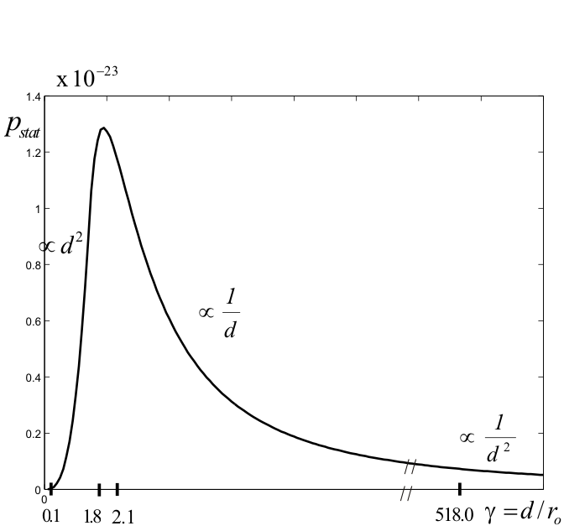
Coulomb
Linear momentum as a function of the distance between static BSPs

Slide 15
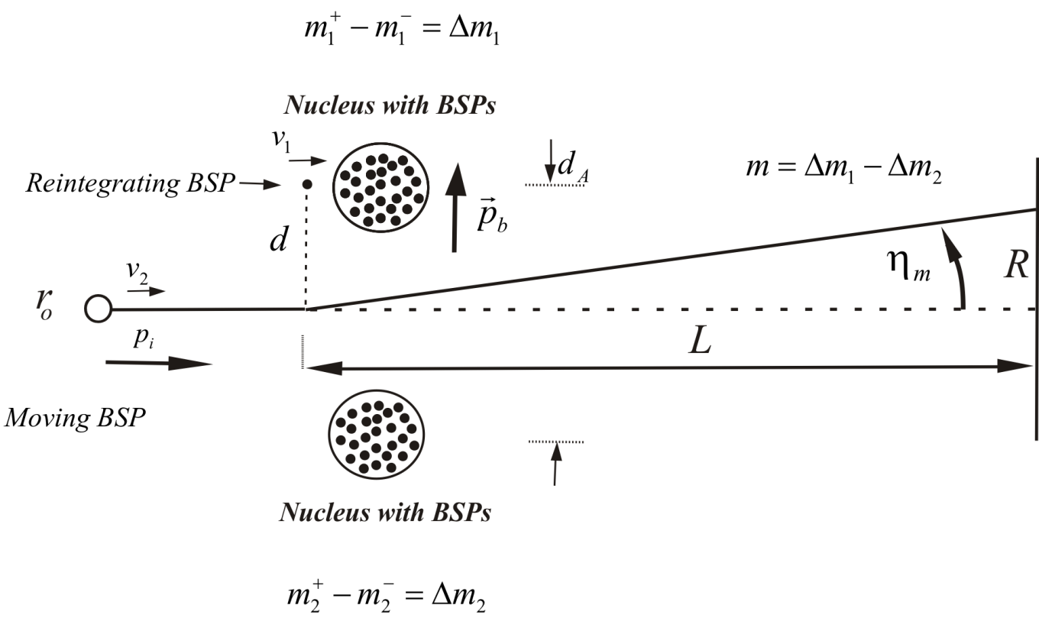
Ampere law
Diffraction of BSPs at a Crystal due to reitegration of BSPs

Slide 16
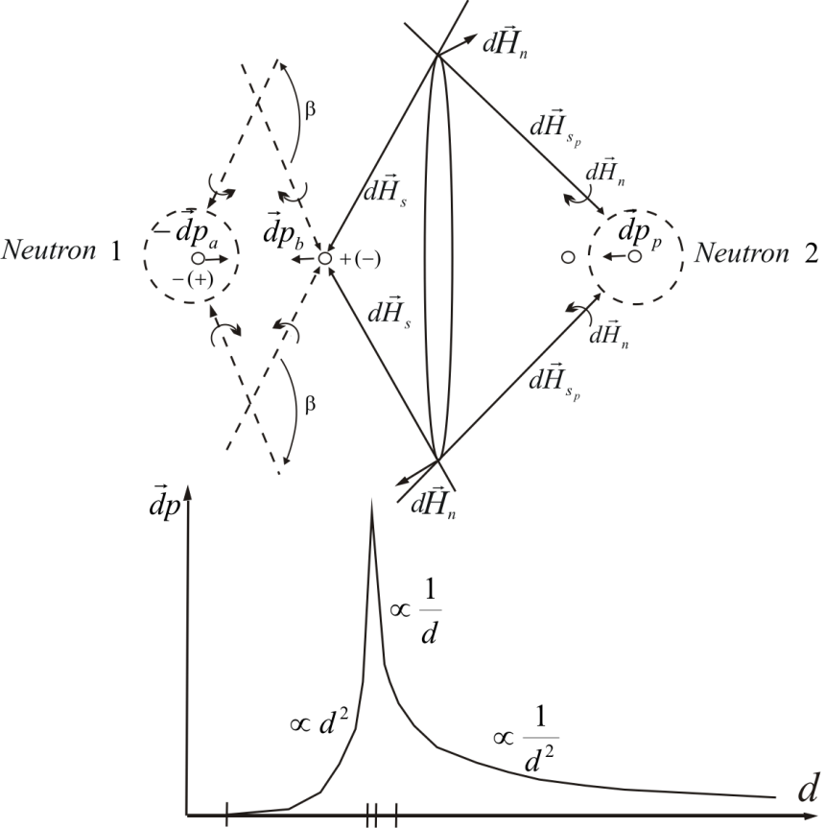
Induction gravitation law
Gravitation between two neutrons due to aligned reintegration of BSPs
At stable nuclei migrated BSPs that interact with
BSPs of same charge do not get the necessary
energy to cross the potential barrier.
At unstable nuclei some of the migrated BSPs that
interact with BSPs of same charge get the
necessary energy to cross the potential barrier.

Slide 17
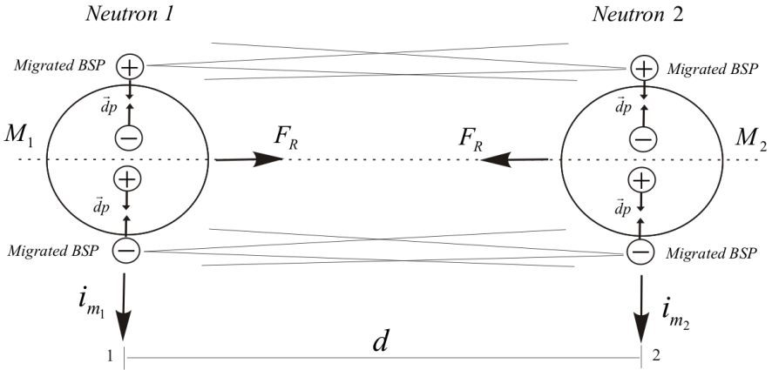
Ampere gravitation law
Gravitation between two neutrons due to parallel reintegration of BSPs

Slide 18
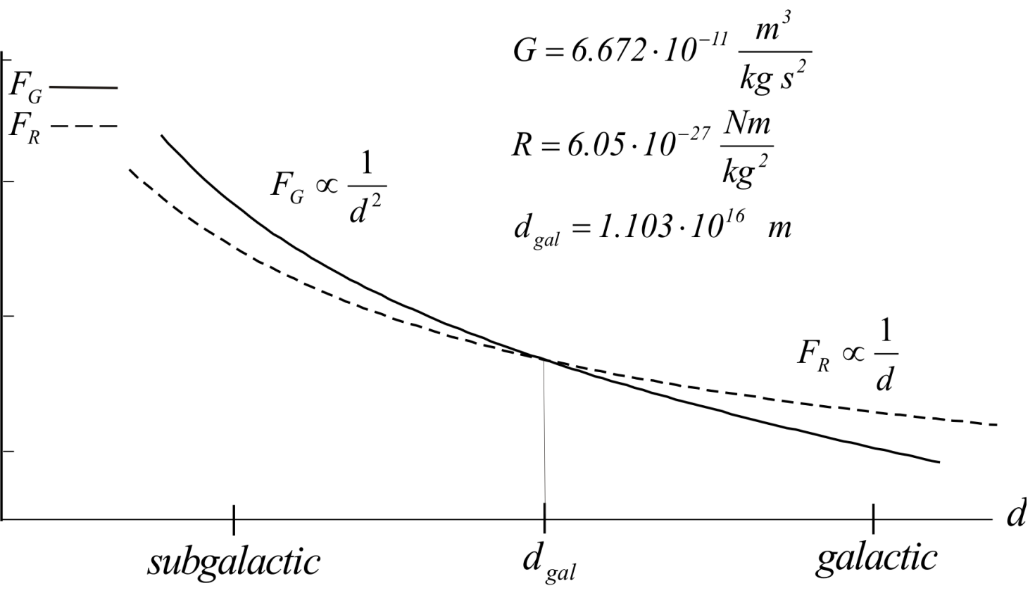
Induction +Ampere gravitation laws
Total gravitation force due to the reintegration of BSPs

Slide 19
Quantification of momenta and forces
-----------------------------------------------------------------------------------------------------
-----------------------------------------------------------------------------------------------------
-----------------------------------------------------------------------------------------------------

Slide 20
Findings of the proposed approach
- Probability and quantification are inherent to the model
- All forces are generated by only one field
- The generation mechanism of forces out of the dH field is defined
- The origin of the charge of a particle is defined
- The inertia of particles with rest mass is explained
- No strong force is required to explain coexistence of charged particles
- No weak force is required to explain radioactivity
- No dark matter is required to explain flattening of galaxie‘s speed curve.
- No dark energy is required to explain accelerated expansion
- etc.

Slide 21
The complete work is available at
www.odomann.com
Thank you for your attention,
Osvaldo Domann
odomann@yahoo.com

